Slide 1

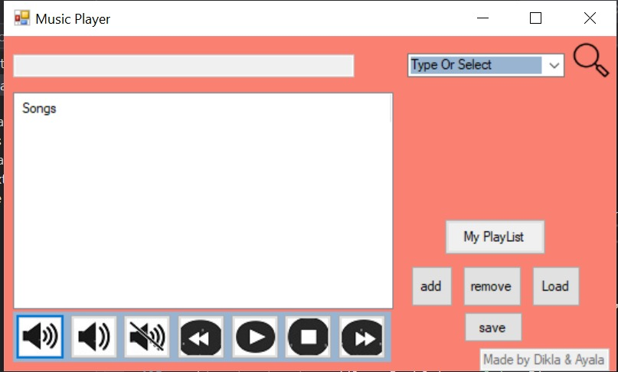
Music Player

Slide 2
The hierarchy of the project
Class Music – Abstract Class
My Playlist
Artist
genre
classic
Rock
Pop

Slide 3
Explanation of the hierarchy
Class Music is an abstract class that has the functions: Play, Stop, PlayNext , PlayPrevious, Display, Shaffle and CurrentSong.
We override those function in the Genre class- we adapted it to work for every genre. In addition we implement a virtual function that represent the instrument of the genre.
Pop, Rock and classic classes heiresses from genre class and uses his functions.
What is the different between the genres?
1. The instrument.
2. Every genre has a different queue of songs.
Artist class heir from music class – we override the functions to work to a specific artist that the account type.
Playlist class heir from music class - we override the functions of music and implement save, remove and load functions.

Slide 4
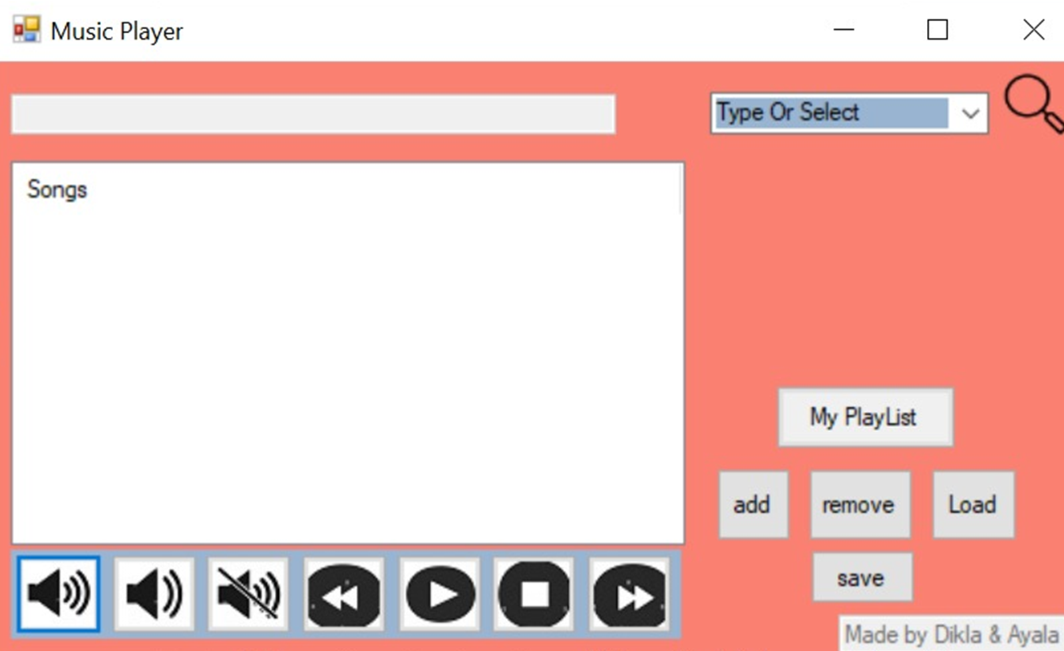
Searching in the app
The search box has two capabilities:
Press on the search box will open a combo box with the genres after press on specific genre its will represent a list of the songs in this genre.
Type a specific artist will represent a list with the songs of this artist. If the artist is not exist in the app it will show correct message.
The list of the song will represent here

Slide 5

Control panel
Volume up
Volume down
Current song and artist name’s will represent.
Mute
Press on the button to play a song \ space in your keyboard
Press on the button stop a song \ space in your keyboard
Back to the previous song
Move to the next song

Slide 6
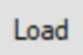
My playlist panel
Press on specific song and then on the add button → the song will be added to your playlist.
Press on my playlist button → will represent your playlist.
Press on a specific song in your playlist and then on the remove button → the song will removed from your playlist.
Press to save your playlist.
After saving your playlist you can load your playlist anytime you want. If your playlist is empty will appear message “Your playlist is empty”.

